Slide 1
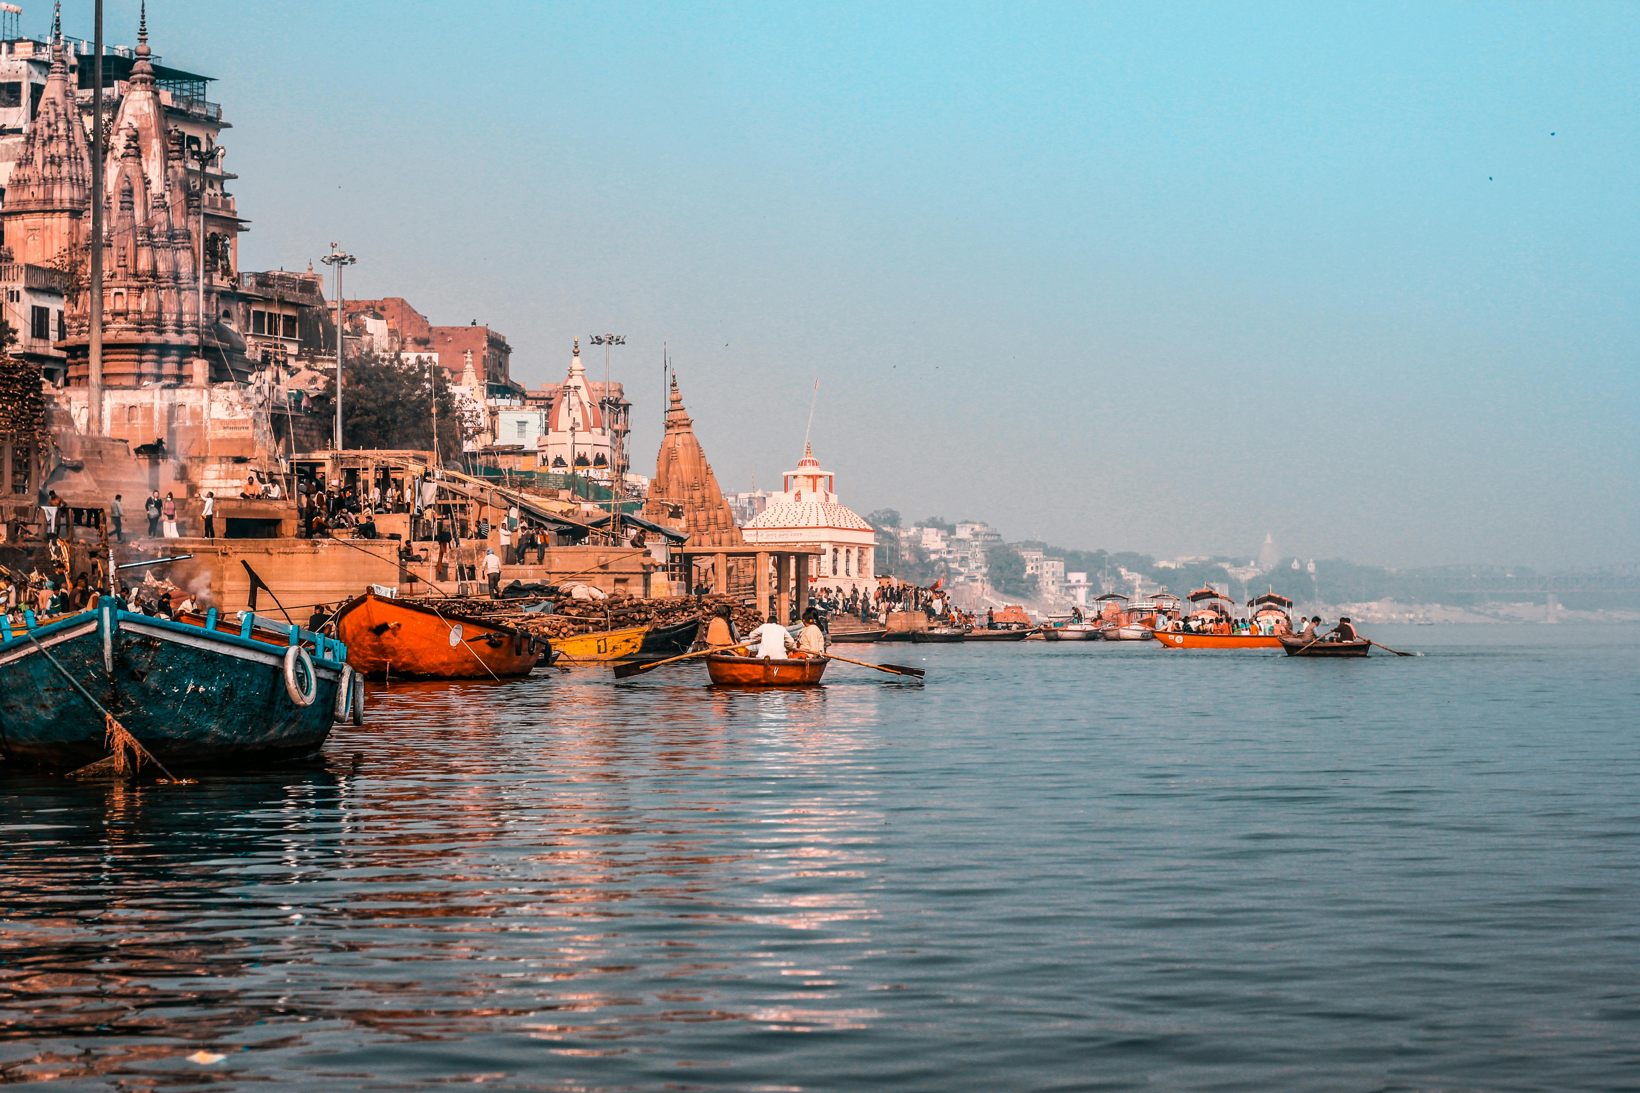
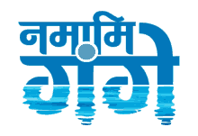

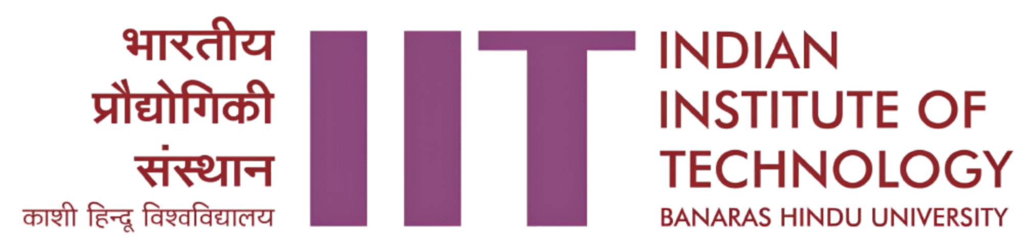
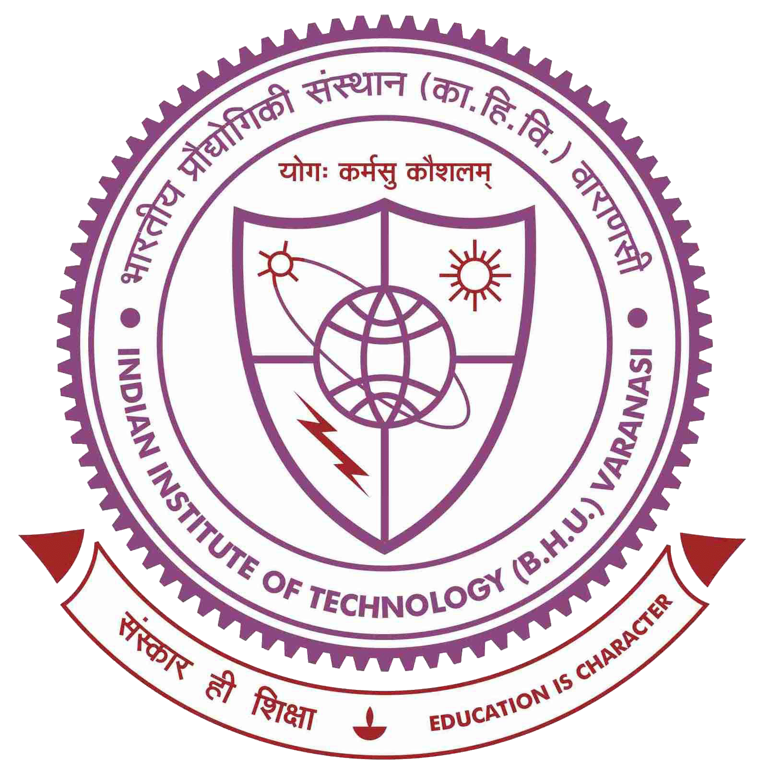
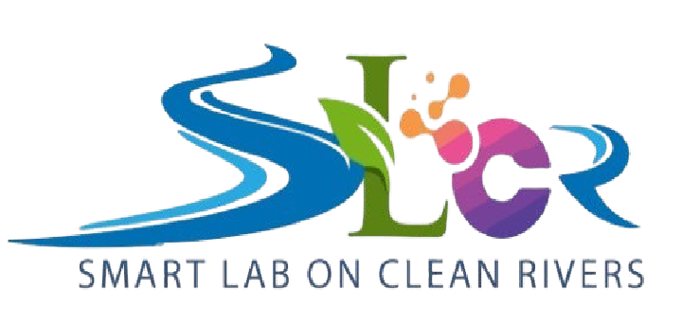
Ganga: A Story from Contamination to Rejuvenation

Slide 2
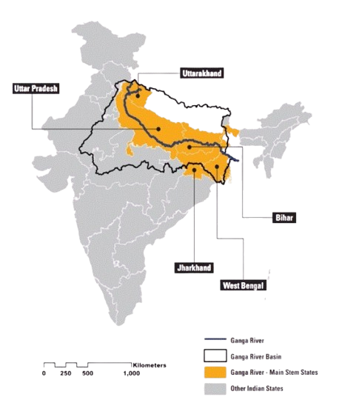
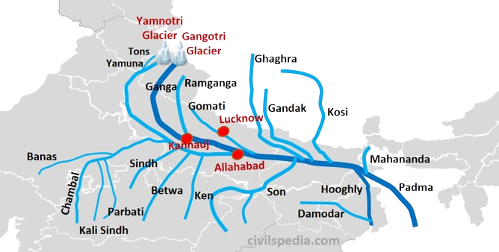
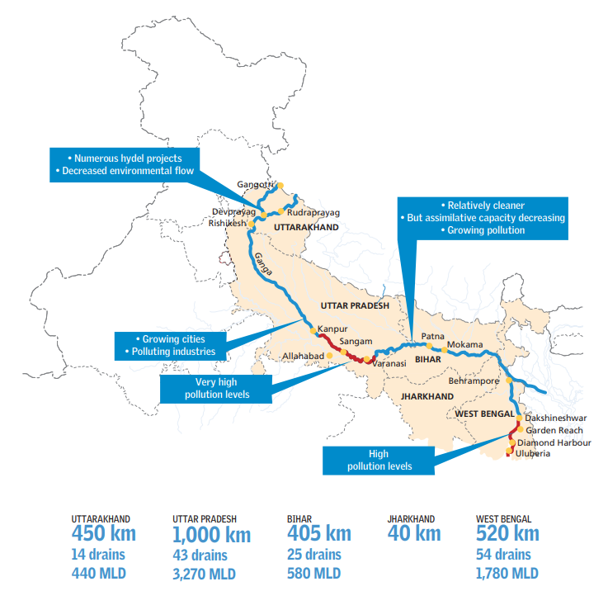
Ganga River System: Largest River System in India
Origin: Gangotri Glacier
Length: 2,525 km
Catchment Area: 8.61 lakh sq. km (26% of the country's land mass)
World's most populated river basin (650 million people)
Basin covers 11 states.

Slide 3
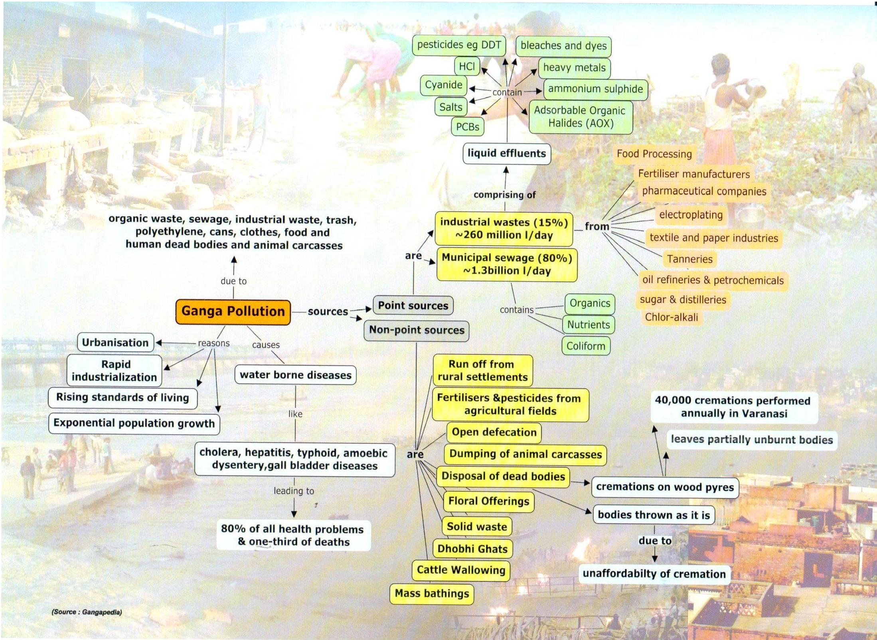

Slide 4
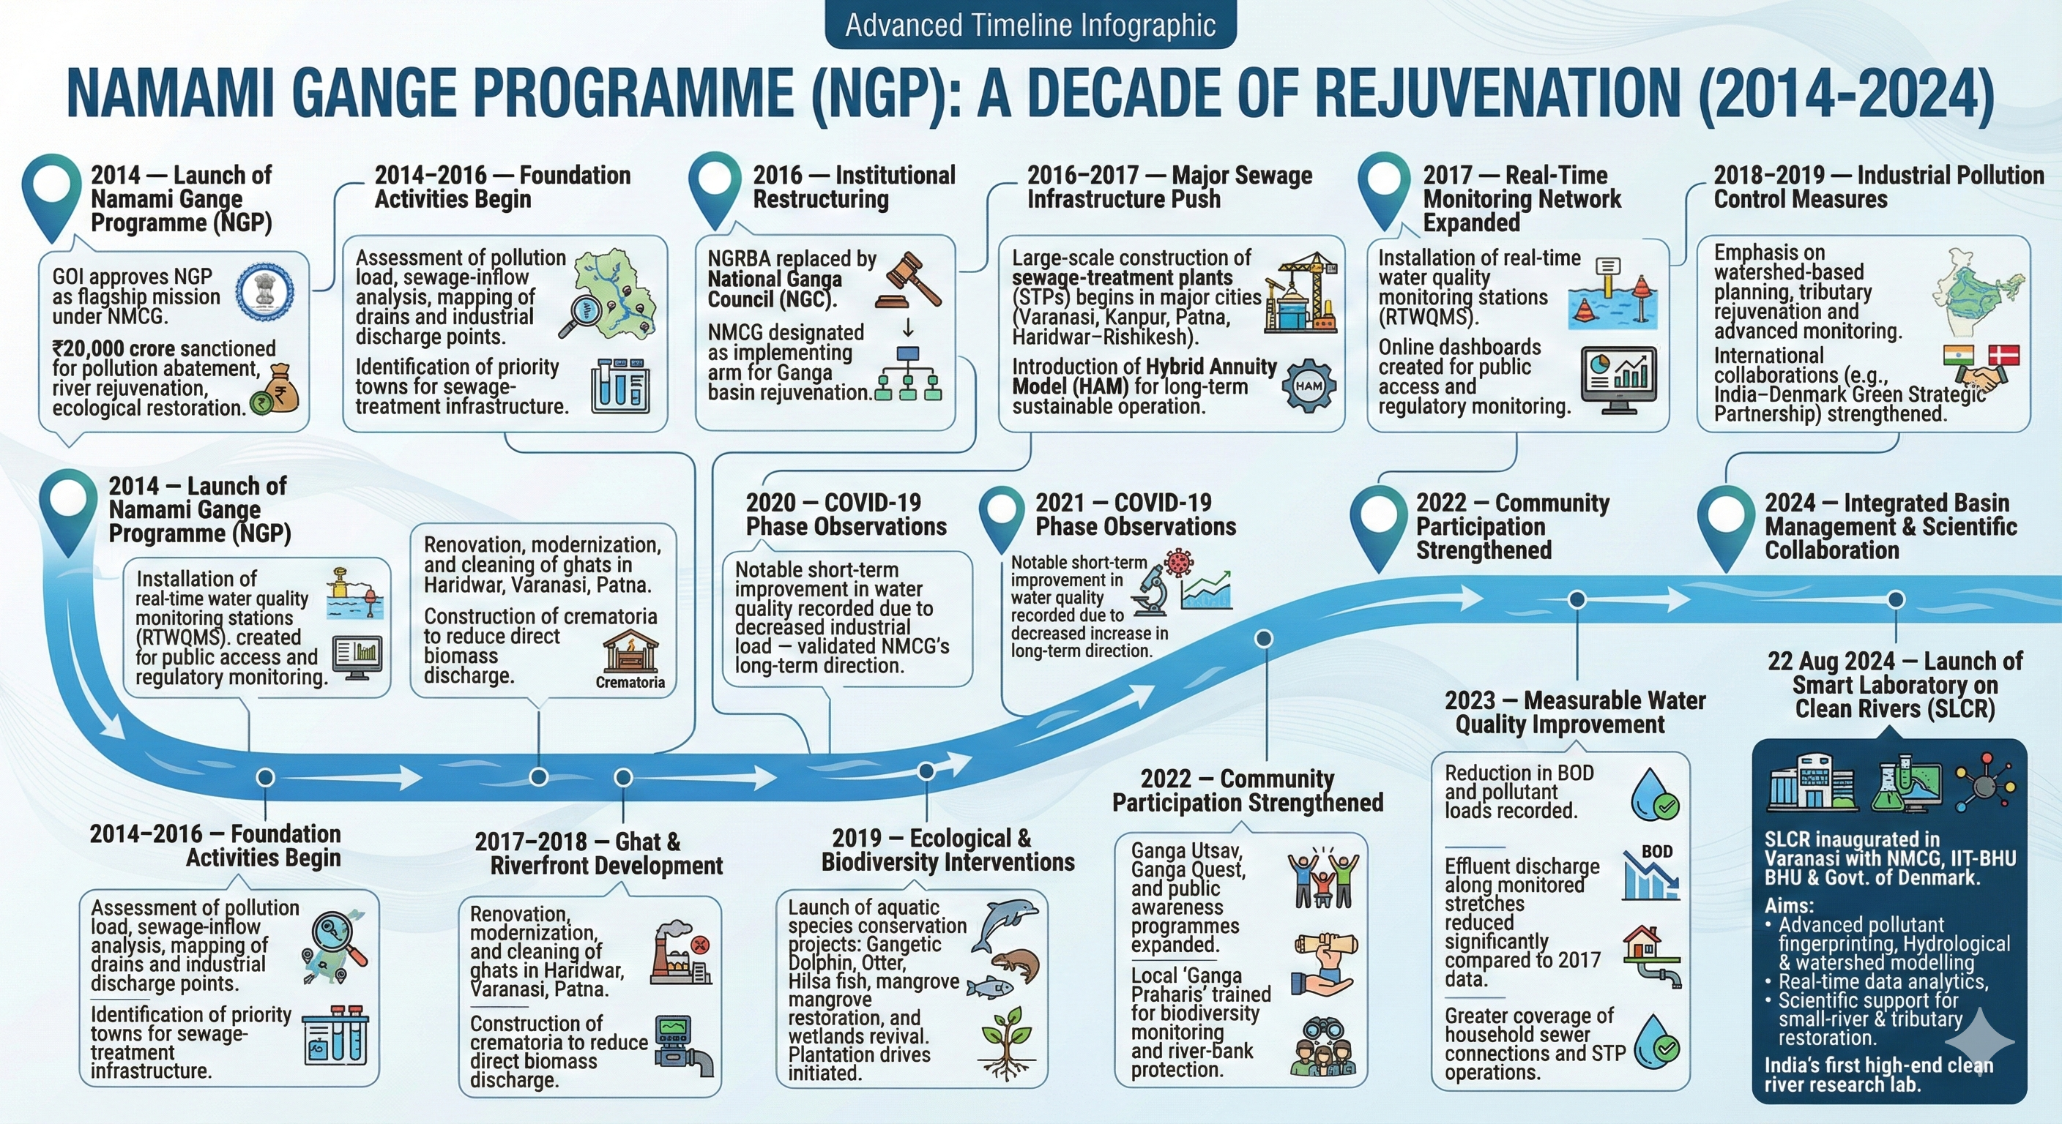

Slide 5
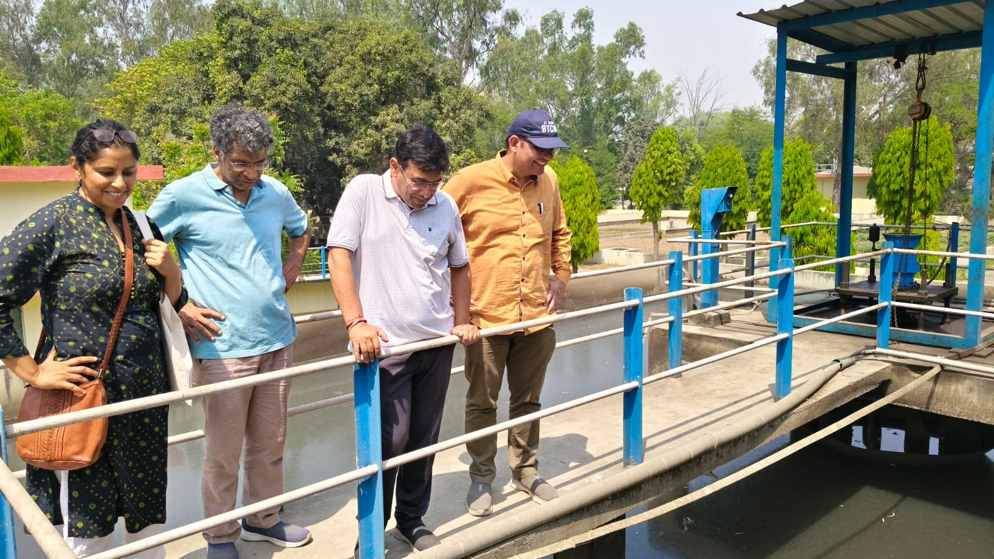
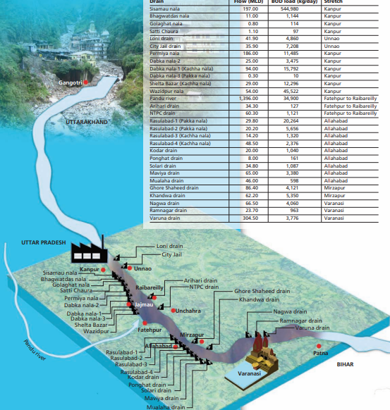
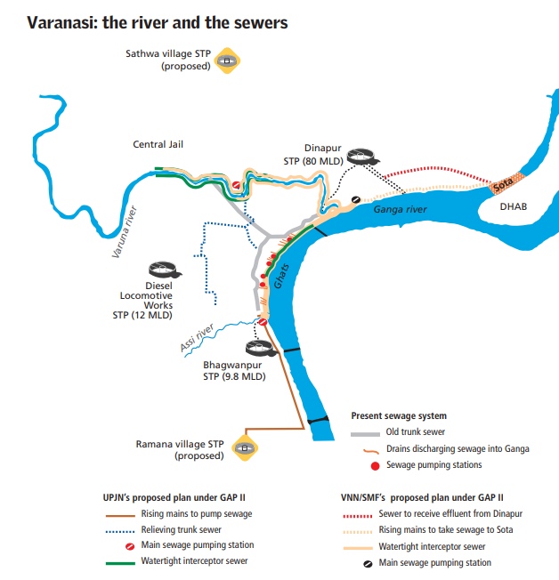
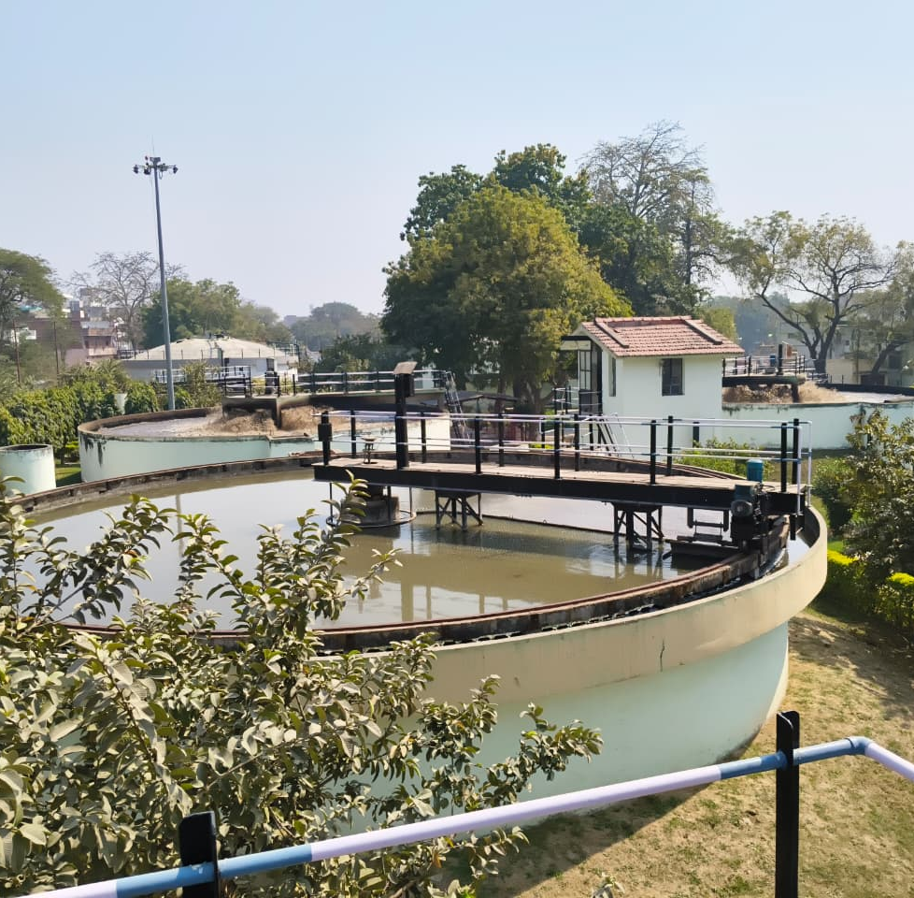

Slide 6
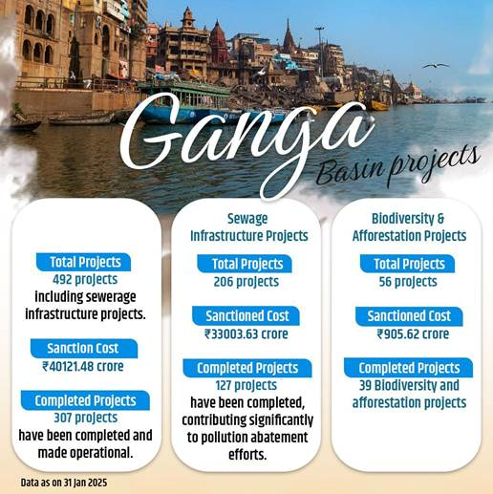
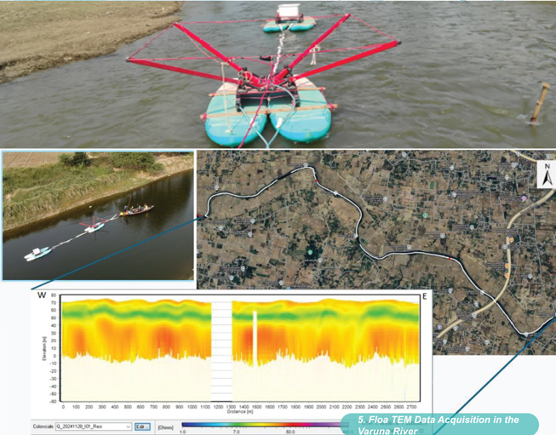
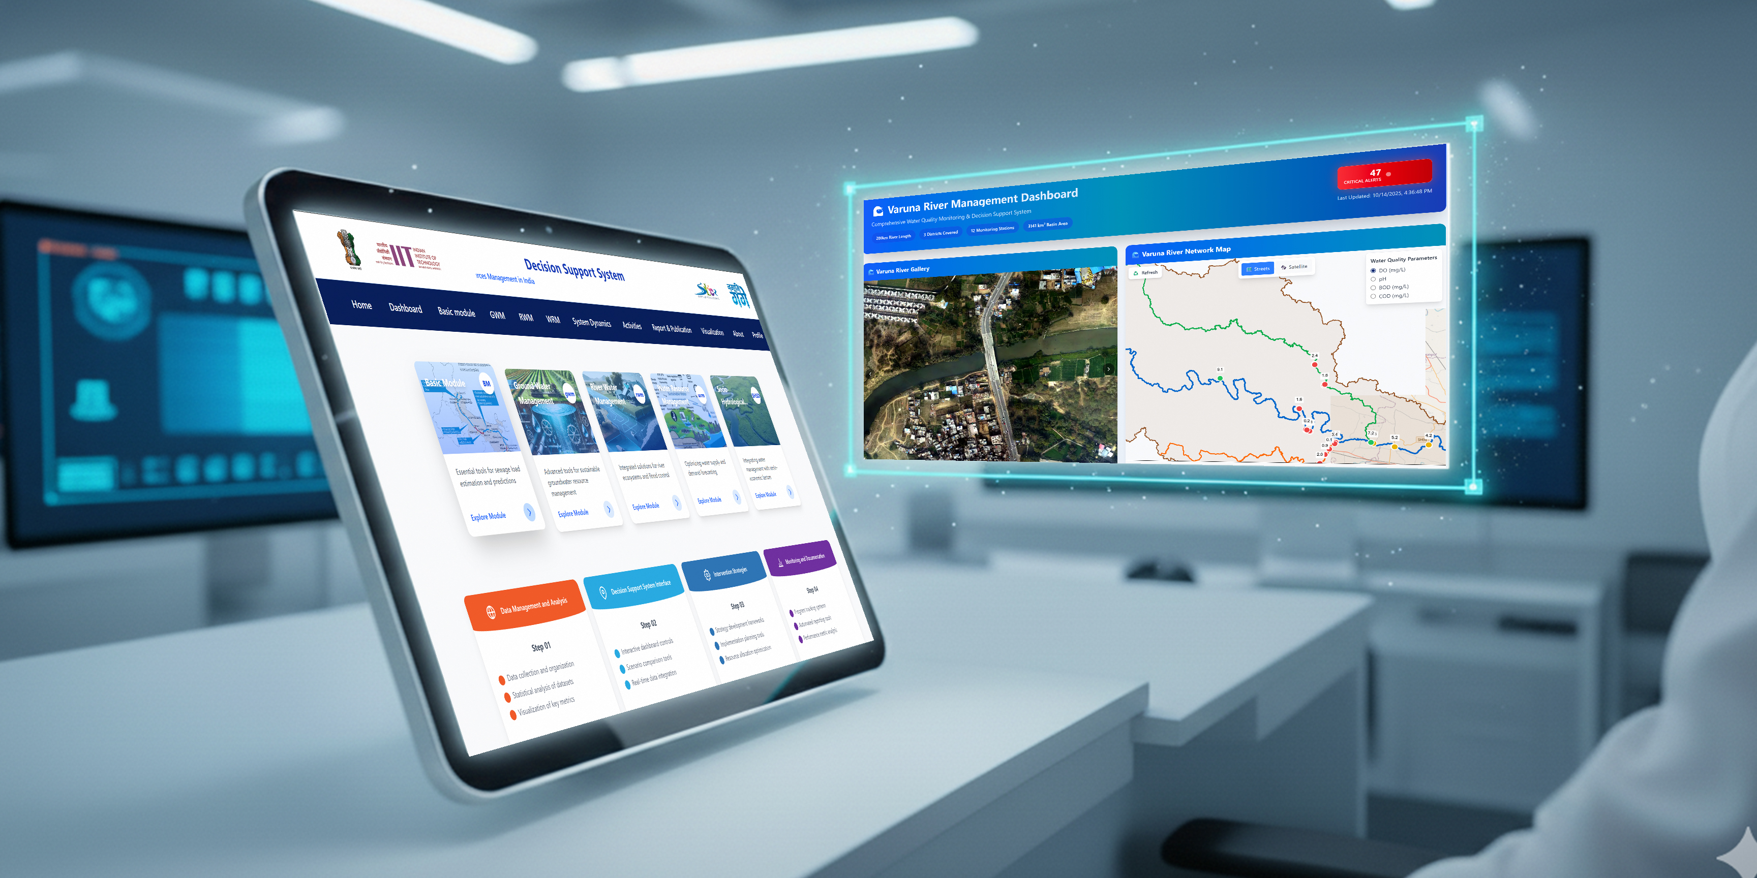
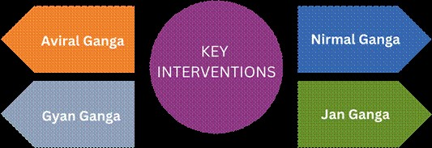
National Mission on Clean Ganga and SLCR
Pollution Abatement (Nirmal Ganga): Addressing and reducing the sources of pollution in the river.
Improving Ecology and Flow (Aviral Ganga): Enhancing the ecological health and continuous flow of the river.
Strengthening People-River Connect (Jan Ganga): Fostering a deeper connection between the people and the river through community engagement and awareness.
Facilitating Research and Policy (Gyan Ganga): Promoting diversified research, scientific mapping, studies, and evidence-based policy formulation

Slide 7
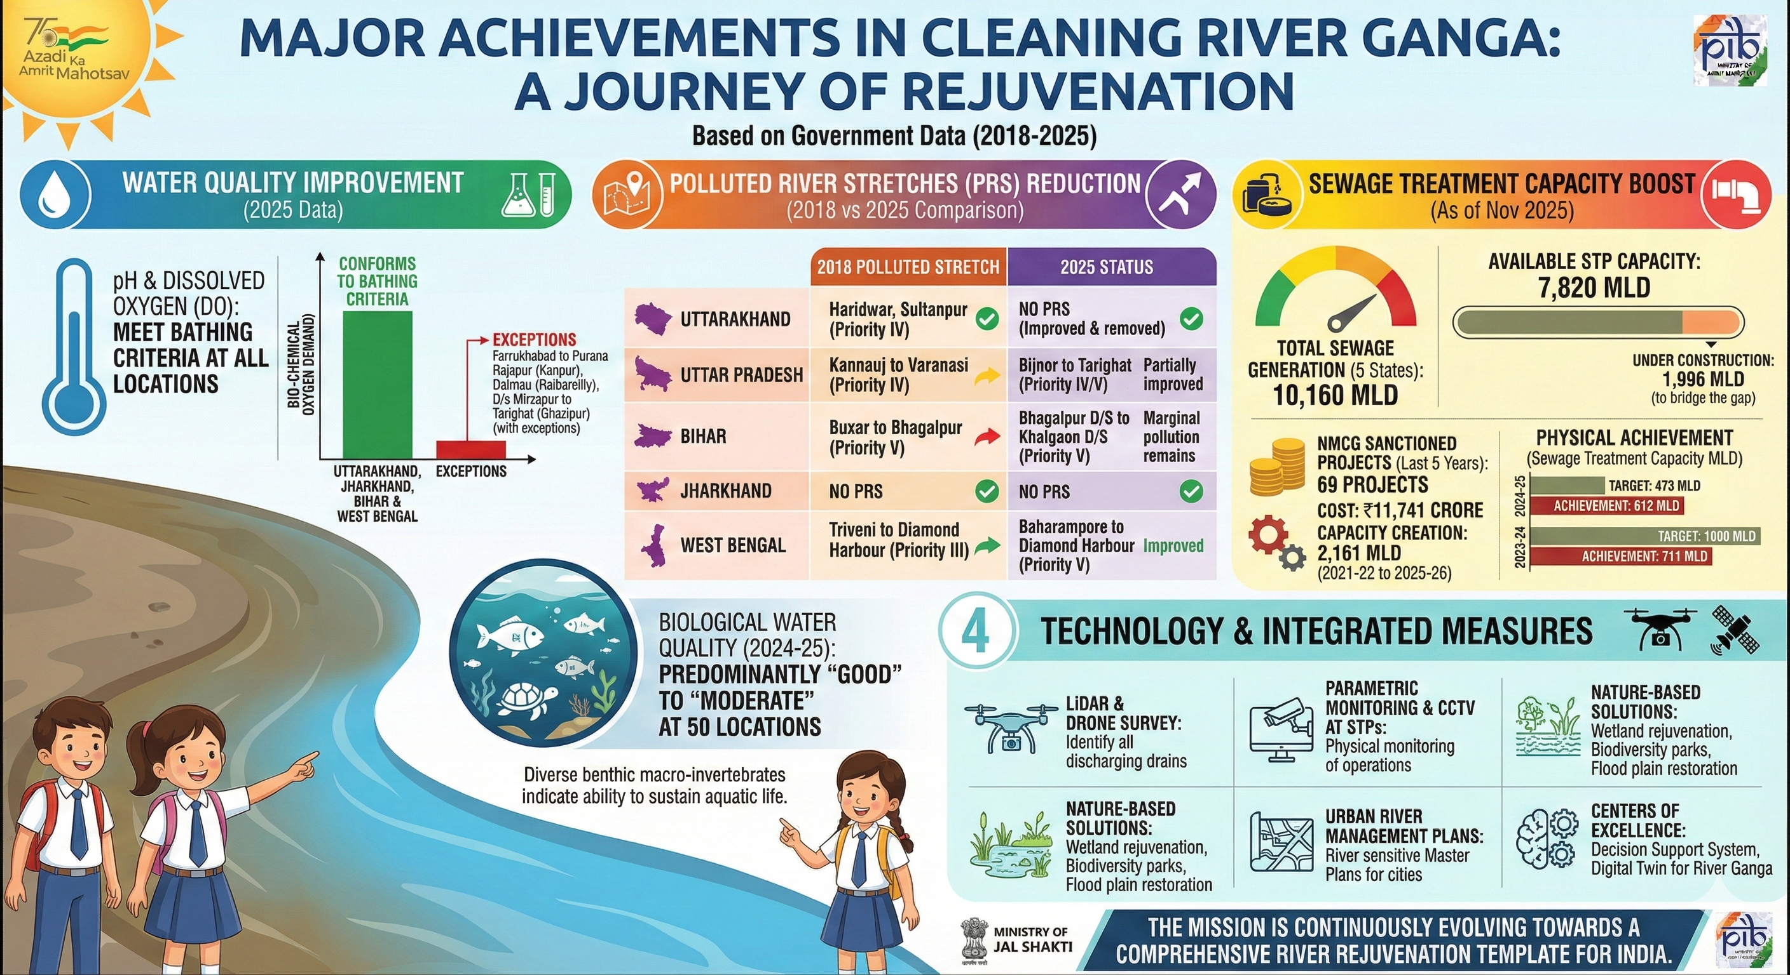

Slide 8
